Slide 1
PRESENTATION
Quantum Information Technology
By Chirag Jain
Guided By:-
Asst. Prof. Mrs Nisha Rana

Slide 2
Content
Introduction
What is Quantum Information Technology?
History of Quantum Information Technology
Components of Quantum Information Technology
Architecture of Quantum Information Technology
How Quantum Information Technology Works
Types of Quantum Information Technology
Technology use in Quantum Information Technology
Functions of Quantum Information Technology
Quantum Information Technology Security Areas
Applications of Quantum Information Technology
Advantages of Quantum Information Technology
Disadvantages of Quantum Information Technology

Slide 3
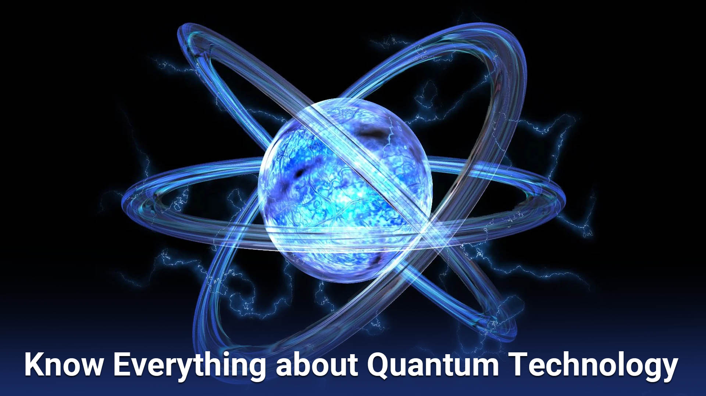
Introduction
Quantum technologies have been under development worldwide for more than 20 years, resulting in promising results and progress.
The main research subject of quantum technology is the interdisciplinary subject of quantum mechanics and Information and Communication Technology (ICT).
Quantum information technology is a multidisciplinary field that seeks to understand the processing and transmission of information using quantum mechanics principles.

Slide 4
What is Quantum Information Technology?
Quantum information refers to both the technical definition in terms of Von Neumannentropy and the general computational term.
It is an interdisciplinary field that involve quantum mechanics, computer science, information theory, philosophy and cryptography among other fields.
Its study is also relevant to disciplines such as cognitive science,psychology and neuroscience.Its main focus is in extracting information from matter at the microscopic scale.

Slide 5
History of Quantum Information Technology
▪ 1950s - Birth of Quantum Mechanics
▪ 1980s - Quantum Computing Concept
▪ 1990s - Quantum Cryptography
▪ 1994 - Shor's Algorithm
▪ Late 1990s - First Quantum Algorithms
▪ Early 2000s - Experimental Progress
▪ 2010s - Rise of Quantum Hardware
▪ Current Era - Quantum Information Technology Ecosystem

Slide 6
Components of Quantum Information Technology
Qubits (Quantum Bits)
Quantum Gates
Quantum Circuits
Quantum Algorithms
Quantum Memory
Quantum Entanglement
Quantum Teleportation
Quantum Sensing and Metrology
Quantum Hardware

Slide 7
Architecture of Quantum Information Technology
Quantum Processing Unit
Quantum Communication Architecture
Quantum Networking
Quantum Key Distribution (QKD) System
Quantum Memory
Quantum Error Correction
Quantum Sensing and Metrology
Quantum Software
Quantum Calibration and Error Monitoring
Quantum Interfaces

Slide 8
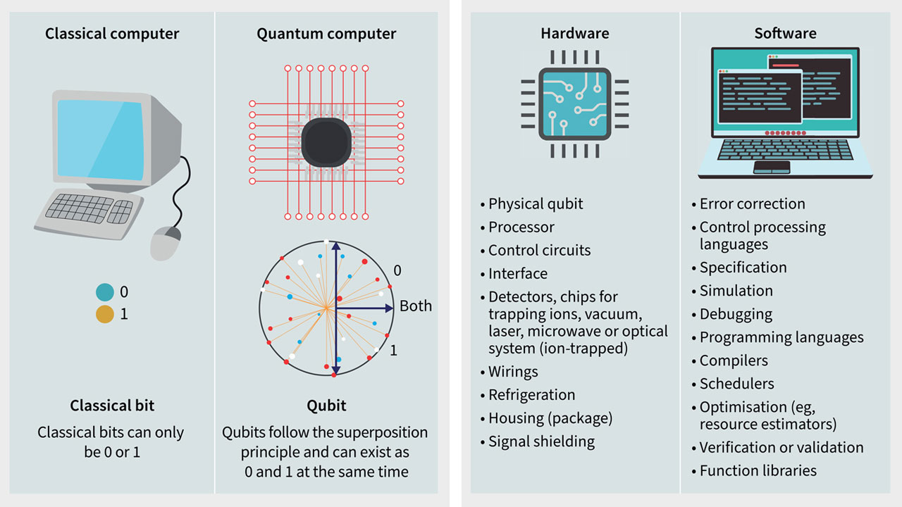
How Quantum Information Technology Works

Slide 9
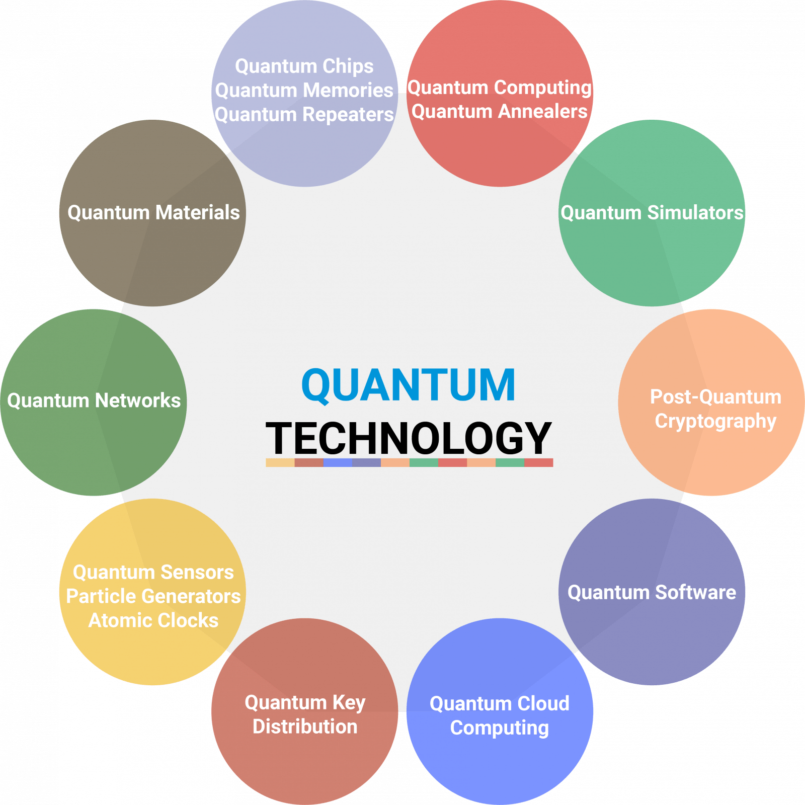
Types of Quantum Information Technology

Slide 10
Technology use in Quantum Information Technology
Quantum Communication
Quantum Cryptography
Quantum Sensing and Imaging
Quantum Internet
Quantum Software
Quantum Algorithms

Slide 11
Functions of Quantum Information Technology
Quantum Algorithms Method
Quantum Software Development
Quantum Materials and Devices
National and International Initiatives
Quantum Ethics and Security
Quantum Supremacy
Quantum Education and Outreach

Slide 12
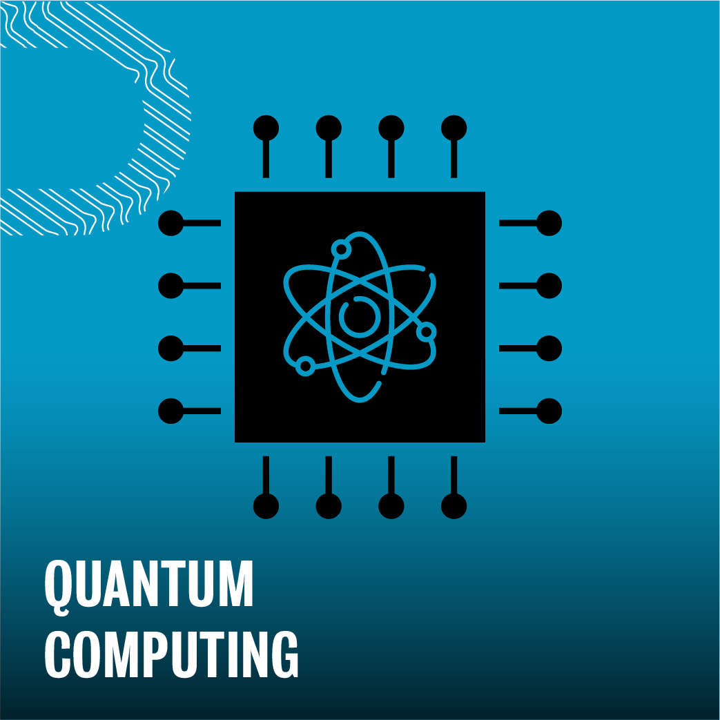
Quantum Information Technology Security Areas
➢ Quantum random number generation is fundamental to cryptography.
➢ Quantum-secure communications, specifically quantum key distribution (QKD).
➢ The most controversial application of QC is its potential for breaking public-key cryptography, specifically the RSA algorithm, which is at the heart of the nearly $4 trillion ecommerce industry.
➢ Machine learning has revolutionized cybersecurity, enabling novel attacks to be detected and blocked.

Slide 13
Applications of Quantum Information Technology
o Artificial Intelligence (AI)
o Better Batteries
o Cleaner Fertilization
o Cybersecurity
o Molecular Simulation
o Electronic Materials Discovery
o Financial Modeling
o Solar Capture
o Traffic Optimization
o Weather Forecasting and Climate Change

Slide 14
Advantages of Quantum Information Technology
Quantum Parallelism
Improved Optimization
Simulating Quantum Systems
Exponential Speedup for Certain Problems
Quantum Machine Learning
Reduced Communication Complexity
Post-Quantum Cryptography
Standardization
Ethical and Security Implications
Resource Requirements
Educational and Workforce Development

Slide 15
Disadvantages of Quantum Information Technology
Technical Complexity
Limited Scalability
High Resource Requirements
Limited Applicability
Quantum Software Development Challenges
Environmental Impact
Security Implications
Interference and Noise
Ethical and Social Implications

Slide 16
Thank you

